Slide 1
What about Writing? n
The Role of Writing in Differentiated Reading Instruction
Sharon Walpole
University of Delaware
Michael McKenna
University of Virginia

Slide 2


Slide 3

Visit us: www.comprehensivereadingsolutions.com

Slide 4
A Stairway to Proficiency
Vocabulary & Comprehension
Fluency and Comprehension
Word Recognition and Fluency
PA and Word Recognition
(K-2 only)

Slide 5
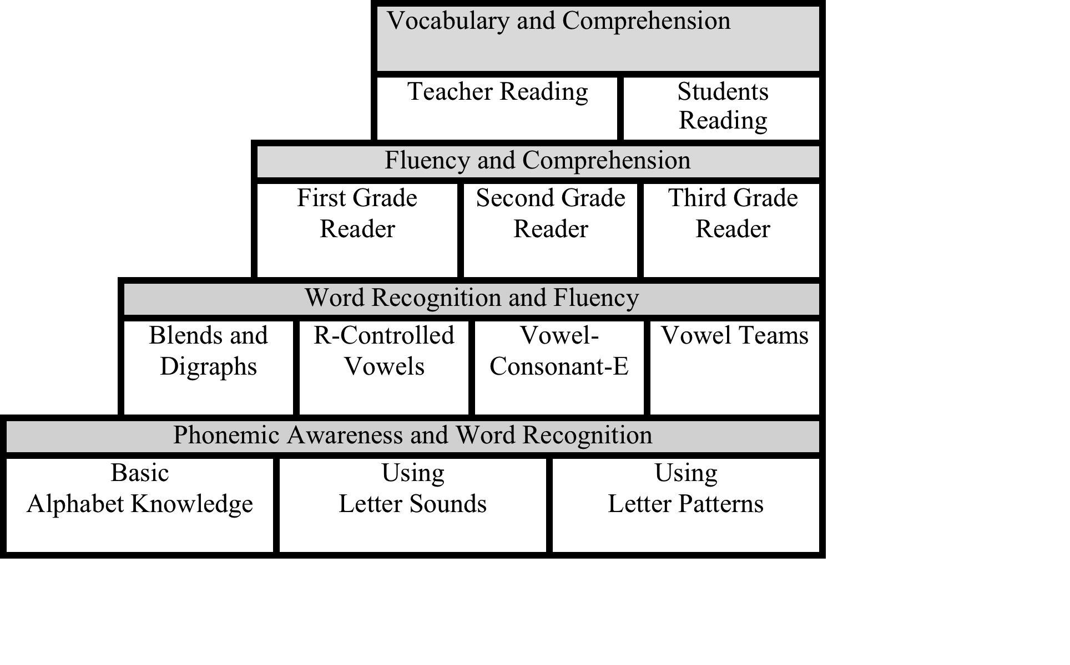
K-3 Skills Groups

Slide 6
Where does writing fit?

Slide 7


Slide 8
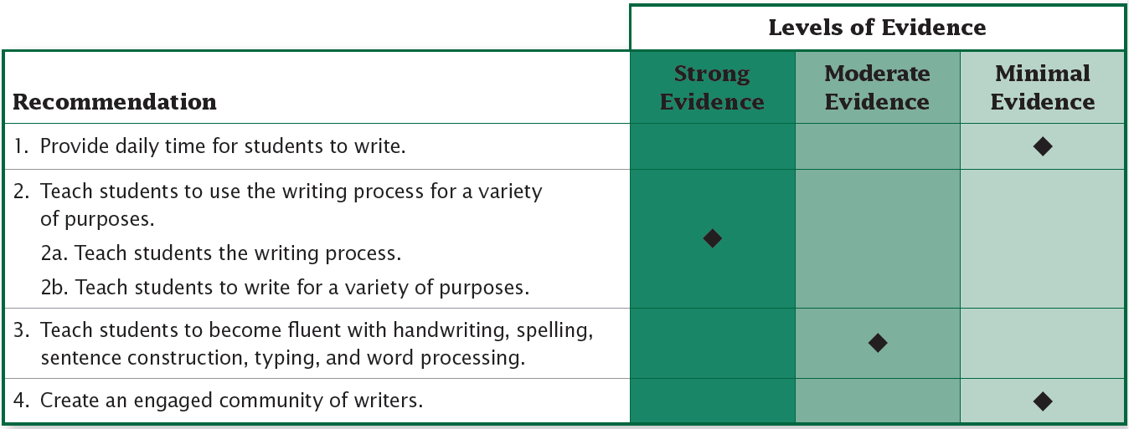
Evidence behind the Recommendations

Slide 9
Schedule for the ELA Block
15 min. | Interactive Read-Aloud
30 min. | Grade-Level Shared Reading Instruction
15 min | Differentiated Instruction | Middle Group | Reading Practice | Reading Practice
15 min. |  | Reading Practice | Lowest Group | Reading Practice
15 min. |  | Reading Practice | Reading Practice | Highest Group
30 - 45 min. | Grade-Level Writing Instruction

Slide 10
Schedule for the ELA Block
Ends with Writing Prompt
15 min. | Interactive Read-Aloud
30 min. | Grade-Level Shared Reading Instruction
15 min | Differentiated Instruction | Middle Group | Reading Practice | Reading Practice
15 min. |  | Reading Practice | Lowest Group | Reading Practice
15 min. |  | Reading Practice | Reading Practice | Highest Group
30 - 45 min. | Grade-Level Writing Instruction

Slide 11
Schedule for the ELA Block
Ends with Writing Prompt
15 min. | Interactive Read-Aloud
30 min. | Grade-Level Shared Reading Instruction
15 min | Differentiated Instruction | Middle Group | Reading Practice | Reading Practice
15 min. |  | Reading Practice | Lowest Group | Reading Practice
15 min. |  | Reading Practice | Reading Practice | Highest Group
30 - 45 min. | Grade-Level Writing Instruction
Students Respond to Prompt during DRI

Slide 12
Writing prompts …
Can follow up on a read-aloud to demonstrate understanding.
Can tie to science or social studies.
Should vary in type.
Should be creative.

Slide 13
Sample Writing Prompts for Fiction
Write a summary of events so far.
Write a diary entry for a character.
Add a journal entry.
Compose an email.
Write an ad.
Make a sign.
Offer a personal connection.
Do some mindreading.
Offer advice.
Make a list.
Draw a map.
Write a blurb.
Make a prediction.
Write sentences using Tier 2 words.

Slide 14
Sample Writing Prompts for Nonfiction
Write a definition.
Write a fact from a chart or diagram.
Make a diagram or chart.
Explain a diagram or chart.
Write a possible sentence.
Write a possible passage.
Write a sentence using content area words.
Write a super sentence.

Slide 15
Schedule for the ELA Block
15 min. | Interactive Read-Aloud
30 min. | Grade-Level Shared Reading Instruction
15 min | Differentiated Instruction | Middle Group | Reading Practice | Reading Practice
15 min. |  | Reading Practice | Lowest Group | Reading Practice
15 min. |  | Reading Practice | Reading Practice | Highest Group
30 - 45 min. | Grade-Level Writing Instruction
Includes Sentence Composing
based on Read-aloud

Slide 16
Schedule for the ELA Block
15 min. | Interactive Read-Aloud
30 min. | Grade-Level Shared Reading Instruction
15 min | Differentiated Instruction | Middle Group | Reading Practice | Reading Practice
15 min. |  | Reading Practice | Lowest Group | Reading Practice
15 min. |  | Reading Practice | Reading Practice | Highest Group
30 - 45 min. | Grade-Level Writing Instruction
Process Writing, unconnected to Read-aloud

Slide 17
Characteristics of Better Writing
More words.
More interesting words.
Varied sentence structures.
More clauses.
Appropriate punctuation.

Slide 18
Let’s write a super sentence from a very boring word
Word
Why?
Where?
When?
How?
What?

Slide 19
Sentence Composing
Learning to write starts at the sentence level.

Slide 20
Schedule for the ELA Block
15 min. | Interactive Read-Aloud
30 min. | Grade-Level Shared Reading Instruction
15 min | Differentiated Instruction | Middle Group | Reading Practice | Reading Practice
15 min. |  | Reading Practice | Lowest Group | Reading Practice
15 min. |  | Reading Practice | Reading Practice | Highest Group
30 - 45 min. | Grade-Level Writing Instruction
Includes Sentence Composing
based on Read-aloud

Slide 21
Focus on Sentences
You may be familiar with the work of Katie Wood Ray. She wants us to learn to write from writers. The idea is compelling, but sometimes hard to envision and implement. There is also no research on it.
A similar approach, called sentence composing, has a strong research pedigree and is easier to implement.
Sentence Composing
Sentence Expanding
Sentence Unscrambling
Sentence Combining
Sentence Imitation

Slide 22
Sentence Scrambling
The teacher breaks a sentence into meaningful parts. Students reassemble the parts, using their knowledge of sentence structure.

Slide 23
Sentence Scrambling
close
to
after
his shop
awfully
a few years
opening
my operation
Uncle Jed
came
Notes:
"Help me here. Which sounds better — this way or this way?" [Read it each way] Or, "Would this word come after that word." [Again, read it each way.] "Which way sounds better?"

Slide 24
Sentence Scrambling
A few years after my operation, Uncle Jed came close to opening his shop.
Notes:
Uncle Jed’s Barbershop

Slide 25
Sentence Combining
The teacher presents two or more related sentences. Students integrate them into one sentence.

Slide 26
Sentence Combining
He rolled back the stone. He entered the cave.

Slide 27
Sentence Combining
He rolled back the stone, and he entered the cave.
He rolled back the stone and entered the cave.
After rolling back the stone, he entered the cave.
Before entering the cave, he rolled back the stone.

Slide 28
Sentence Expanding
The teacher presents a simple sentence. Students develop it further by adding content and making the syntax more complex.

Slide 29
Sentence Expanding
He entered the cave.
Why? Because he was hiding
When? During the thunderstorm
How? Crawling on his hands and knees
Where? Through the tiny, hidden entrance

Slide 30
Sentence Imitating
The teacher presents a sentence from the text. Students use the author’s syntax, but change the content.
Notes:
"Here is one sentence from our book: 'It was cold in the wall.'" [Finger-point read the sentence.] "I can make many different sentences that are like this one. Instead of saying 'cold,' I might say … 'wet.' and instead of 'wall,' I might say … 'bathtub.' [Write the new sentence below the original and finger-point read it.] 'It was wet in the bathtub.' So instead of 'cold' I wrote 'wet' [point to each word] and instead of 'wall' I wrote 'bathtub.' Now, I want you to help me make some more new sentences by putting in new words. Let's start. What can I say instead of 'cold'?" [and so forth]

Slide 31
Sentence Imitating
They were in a country of swirling mists and ghostly vapors.
They were in a crowd of shouting people and bad manners.
They were beside a hedge of prickly thorns and thick branches.

Slide 32
Focus on Sentences First
.
Sentence Composing
Sentence Expanding
Sentence Unscrambling
Sentence Combining
Sentence Imitation

Slide 33
But look for more work on writing instruction, and particularly on argumentative writing, on our website soon.

